Slide 1
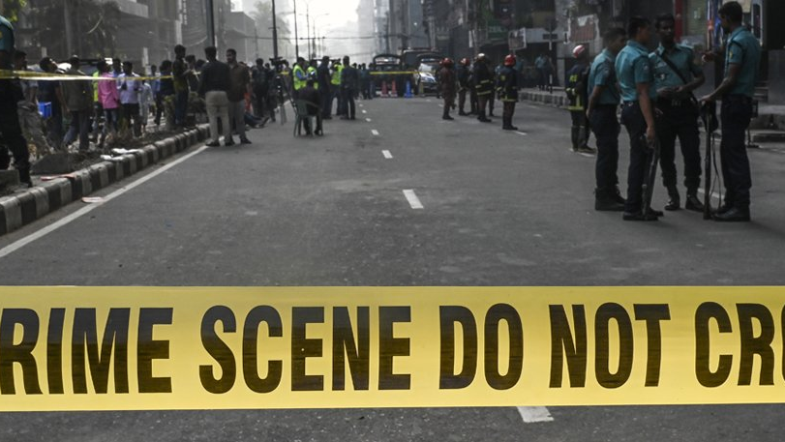
IN DHAKA CITY
CRIME
Presented by
SHOHANUR RAHMAN SHOHAN
FARJANA YESMIN OPI
LIDA KHAN MUKTI
NAZIM-E-ALAM
MD. ABU TOWSIF

Slide 2

What is
Crime
An act (or sometimes a failure to act) that is deemed by statute or by the common law to be a public wrong and is therefore punishable by the state in criminal proceedings
In ordinary language, a crime is an unlawful act punishable by a state or other authority
Criminology is the interdisciplinary study of crime and deviant behavior
In this presentation, we will discuss about the present and past scenario of crime in Dhaka city

Slide 3
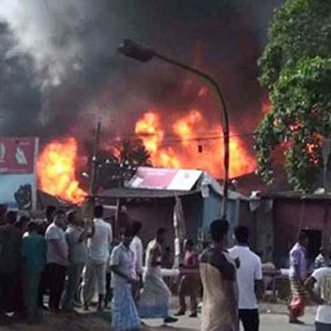
CRIME IN BANGLADESH OVERVIEW
Bangladesh, with its rich culture and history, is grappling with various types of crime that require comprehensive analysis and effective solutions
Crime is a multifaceted issue that affects societies globally, and Bangladesh is no exception
Rapid urbanization has led to increased population density and crime concentration
The rise of cybercrime has introduced new challenges, requiring the adaptation of traditional law enforcement strategies to the digital realm

Slide 4
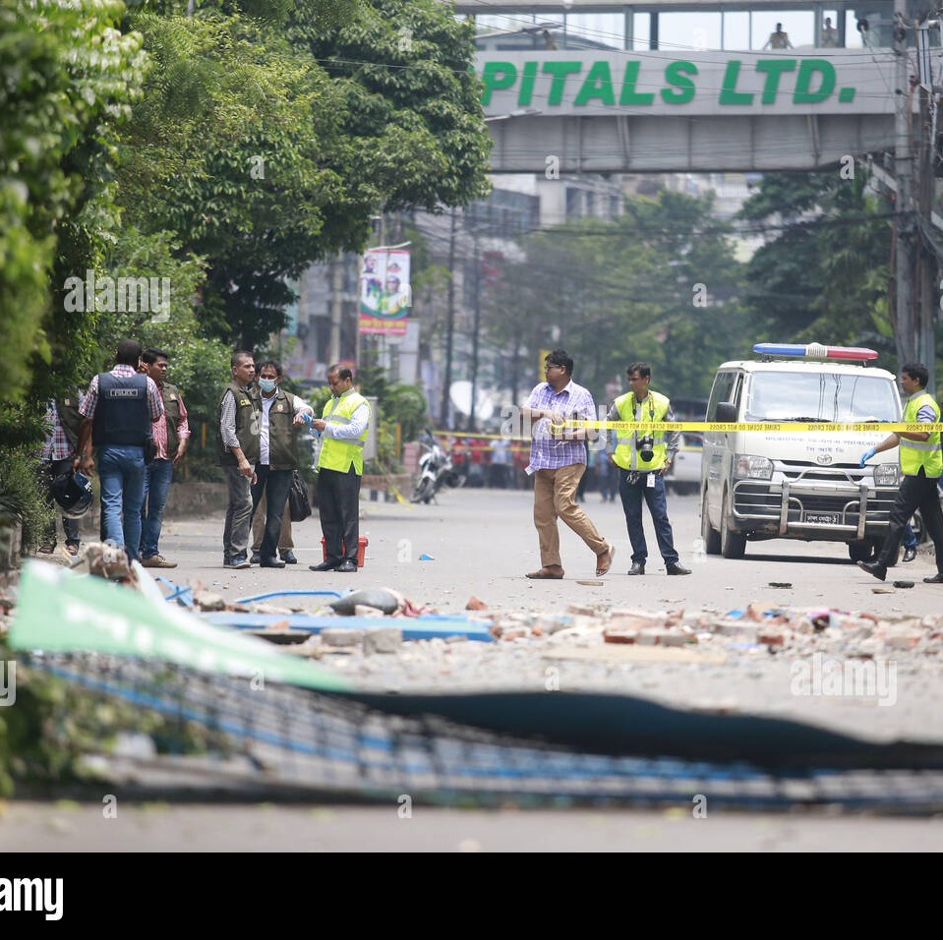
CRIME IN DHAKA CITY
Dhaka City, the bustling capital of Bangladesh, grapples with a diverse range of criminal activities that reflect the complexities of urban life
From street crime to cybercrimes, Dhaka City's crime landscape encompasses a spectrum of offenses that challenge law enforcement and society
Violent crimes, such as robberies and assaults, pose threats to public safety, prompting a need for strategic measures to ensure citizen protection
Women's safety remains a pressing concern, as gender-based violence and harassment persist in various corners of Dhaka City

Slide 5

TYPES OF
CRIME
STREET ROBARIES
Street robberies are common, especially in densely populated areas. Criminals often snatch belongings from pedestrians or motorcyclists, leading to instances of theft and assault
Pickpocketing
Crowded places like markets and public transport are breeding grounds for pickpockets who discreetly steal wallets, phones, and other valuables from unsuspecting individuals
Vehicle Theft
Carjacking and motorbike theft are prevalent, with criminals stealing vehicles for resale or parts. Lack of proper parking and security measures contribute to this issue.
KIDNAPPING
is a criminal act in which an individual or a group forcibly and unlawfully takes another person against their will, often with the intent to demand a ransom, inflict harm, or exert control over the victim
FRAUD
Scammers often exploit unsuspecting individuals through schemes involving fake investments, lotteries, or other fraudulent activities
Drug Trafficking
Dhaka City's urban environment attracts drug trafficking, with both local distribution and transit routes for international drug trade.

Slide 6
TYPES OF contd.
CRIME
DRUGS
The scourge of drug-related crimes continues to cast a shadow over Dhaka City, with illicit drug trade and abuse posing significant challenges. Law enforcement agencies are engaged in an ongoing battle to curb the distribution and consumption of drugs, striving to protect the city's communities from the harmful effects of addiction and associated criminal activities
Human Trafficking
Dhaka City serves as a source, transit, and destination point for human trafficking, affecting men, women, and children for various exploitative purposes
CYBER CRIME
Dhaka City experiences various forms of cybercrime, including online scams, hacking, and identity theft, as the digital landscape expands
FRAUD
Scammers often exploit unsuspecting individuals through schemes involving fake investments, lotteries, or other fraudulent activities
Environmental Crimes
Illegal waste disposal, air and water pollution, and other environmental violations contribute to the degradation of the city's ecosystem

Slide 7
DATA & STATISTICS

Slide 8
DATA & STATISTICS

Slide 9
CAUSES OF
CRIME
Impoverishment and unemployment
The impoverishment of Bangladesh peoples has been a troubling social. Shortly after independence, about 82% of rural areas, an estimated 35% of the population lives below the impoverishment line and approximately 21% of the population lives below the impoverishment line in urban areas ( P.B., 2020). These Bangladeshis have poor access to health care and safe drinking water ( Jahan, 2018). The rapidly increasing population increase is one of the major causes of rural impoverishment. the population stayed below the impoverishment line. Due to unemployment, most young people are involved in drugs and crime.

Slide 10
CAUSES OF
CRIME
Drug addiction
Day by day drug addiction is increasing, from elder to child. All are addicted to many different types of drugs. Almost all types of drugs are available in Bangladesh and mostly drugs supplier are selling drugs from the evening. About 43 percent of the country’s unemployed population is drug-addicted and in Bangladesh over 7.5 million people are drug-addicted. 80 percent of them are young people, 50 percent of whom are involved in multiple criminal activities. 48% of drug users are educated and 40 percent are uneducated out of the number. This drug addiction is one of the main reason to commit criminal offenses in Dhaka city

Slide 11
CAUSES OF
CRIME
Depression and mental Disorder
Depression and mental disorders can contribute to criminal behavior due to factors such as impaired decision-making, substance abuse as a coping mechanism, poverty and homelessness leading to desperation, self-medication attempts, lack of social support fostering anger and isolation, reduced ability to comprehend consequences, and the interaction of co-occurring disorders. However, it's important to note that while these factors might increase the risk, the majority of individuals with mental disorders do not engage in criminal activities, and with proper support and treatment, the likelihood of such behavior can be significantly reduced

Slide 12
CAUSES OF
CRIME
Abuse of political power
Recently a common thing is the abuse of political power. Some people are very strongly involved with this. The government is sending relief for homeless and poor people, but they are not getting this relief. As soon as government relief arrives, they are sharing among themselves. Crime is being created today for all these influential people. Influential people are creating terror. Influential people are taking advantage of the weakness of the poor and uneducated people
State of the family
Most crimes start from the family and later spread to the society. The initiation of all types of crime is family unrest and property. Since most families in the village are poor and illiterate, that’s why there is no opportunity to consider what is right and what is wrong. An uneducated family cannot teach a proper lesson to their family child. In that cause, girls are getting married at an early age, children are involved in crime and children are taking drugs, being terrorists, carrying weapons, and beginning an illegal business

Slide 13
CAUSES OF
CRIME
Abuse of political power
Recently a common thing is the abuse of political power. Some people are very strongly involved with this. The government is sending relief for homeless and poor people, but they are not getting this relief. As soon as government relief arrives, they are sharing among themselves. Crime is being created today for all these influential people. Influential people are creating terror. Influential people are taking advantage of the weakness of the poor and uneducated people
State of the family
Most crimes start from the family and later spread to the society. The initiation of all types of crime is family unrest and property. Since most families in the village are poor and illiterate, that’s why there is no opportunity to consider what is right and what is wrong. An uneducated family cannot teach a proper lesson to their family child. In that cause, girls are getting married at an early age, children are involved in crime and children are taking drugs, being terrorists, carrying weapons, and beginning an illegal business

Slide 14
IMPACT ON SOCIETY
Safety and Security Concerns
High crime rates can lead to feelings of insecurity among the general population, affecting people's daily lives, routines, and overall well-being.
Economic Effects
Crimes can negatively impact the economy by deterring foreign investment, hindering business growth, and increasing costs related to security and law enforcement. The fear of crime might lead to reduced consumer spending and tourism, affecting various sectors

Slide 15
IMPACT ON SOCIETY
Social Disruption
Crimes can disrupt the social fabric of a society, eroding trust and community cohesion. People might become more isolated, leading to a breakdown in social relationships and support networks.
Psychological Impact
Crimes can cause psychological trauma not only for victims but also witnesses and the larger community. This trauma can have long-lasting effects on mental health and well-being.
Healthcare Burden
Healthcare resources may be diverted to treat victims of crime, adding to the strain on an already stretched healthcare system.

Slide 16
IMPACT ON SOCIETY
Educational Disruption
High crime rates can disrupt education, as students and parents might fear going to schools located in unsafe areas. This can lead to decreased educational attainment and future opportunities for young people.
Decreased Productivity
Crime can lead to increased absenteeism, decreased work productivity, and a generally disrupted work environment, affecting economic productivity on an individual and societal level
Legal and Judicial Strain
High crime rates can strain the legal and judicial systems, leading to backlogs in court cases, increased workload for law enforcement, and potential corruption within these systems

Slide 17
IMPACT ON SOCIETY
Stigma and Discrimination
Certain crimes can lead to stigmatization of specific communities, further dividing society along ethnic, religious, or socioeconomic lines
Migration and Urbanization
Crime can influence migration patterns as people may move away from high-crime areas, leading to uneven urbanization and potential overcrowding in safer areas
Impact on Tourism
Crime can deter tourists from visiting a country, leading to decreased revenue for the tourism industry and affecting local economies that rely on tourism

Slide 18
CRIME AND GOOD GOVERNANCE
The link between crime and good governance is profound, as effective governance plays a crucial role in preventing and addressing criminal activities. Good governance, characterized by transparency, accountability, strong institutions, and the rule of law, establishes a framework that discourages criminal behavior by ensuring fair and just systems. It enables law enforcement agencies to operate efficiently, promotes the swift delivery of justice, and fosters an environment where citizens trust institutions. When governance is weak or corrupt, criminals can exploit loopholes, evade justice, and manipulate systems, leading to higher crime rates, eroded public trust, and social unrest. Thus, the strength of governance significantly influences a society's ability to manage and reduce crime effectively.

Slide 19
CRIME AND GOOD GOVERNANCE
good governance contributes to crime prevention through socio-economic development and the provision of basic services. When governments prioritize education, healthcare, employment opportunities, and social welfare programs, they address some of the underlying factors that can lead to criminal behavior, such as poverty and desperation. Transparent and accountable governance also helps in curbing corruption, which can be a driving force behind various criminal activities. Furthermore, collaboration between law enforcement agencies, judiciary, and other government bodies is essential for effective crime control. Overall, a well-governed society creates an environment that discourages criminal behavior while promoting the well-being and security of its citizens

Slide 20
STRATEGIES AND RECOMMENDATIONS
Community Policing and Engagement:
Establish strong community-police partnerships to foster trust and collaboration. Encourage police officers to interact positively with residents, understand local concerns, and work together to address issues.
Enhanced Law Enforcement: I
Increase police presence in high-crime areas and implement effective patrolling strategies. Modernize the police force with technology, surveillance, and data-driven crime analysis to better allocate resources.
Youth Engagement and Education:
Develop programs that engage young people in positive activities and skill-building to divert them from criminal influences. Invest in quality education and vocational training opportunities to improve future prospects.

Slide 21
STRATEGIES AND RECOMMENDATIONS
Crime Prevention Through Environmental Design (CPTED)
Design urban spaces with safety in mind, focusing on well-lit streets, clear signage, and well-maintained public areas that discourage criminal activities.
Social Services and Rehabilitation
Establish programs that support individuals at risk of criminal involvement, such as substance abuse counseling, mental health services, and reintegration programs for ex-offenders.
Strengthening Legal Institutions
Ensure a swift and fair judicial process by reducing case backlogs, increasing efficiency, and implementing restorative justice practices when appropriate.

Slide 22
STRATEGIES AND RECOMMENDATIONS
Youth Mentorship and Role Models
Foster mentorship programs and provide positive role models for young people, showing them constructive pathways to success.
Public Awareness Campaigns
Run campaigns that raise awareness about crime prevention, safety measures, and citizens' responsibilities in maintaining a secure environment.
Technology for Safety
Utilize technology, such as surveillance cameras, crime reporting apps, and emergency helplines, to empower citizens to report crimes and emergencies promptly.

Slide 23
STRATEGIES AND RECOMMENDATIONS
Strengthening Urban Planning
Collaborate with urban planners to create safe, walkable neighborhoods that discourage criminal activities by promoting community interaction.
Addressing Socio-Economic Disparities
Work on reducing poverty and inequality through social and economic development programs, as these factors can contribute to crime.
Anti-Corruption Measures:
Implement measures to reduce corruption within law enforcement and other government institutions, ensuring that resources are allocated fairly and transparently.
Public-Private Partnerships
Collaborate with businesses and private sector entities to support crime prevention initiatives, including funding for community programs and security measures.

Slide 24
STRATEGIES AND RECOMMENDATIONS
Data-Driven Strategies
Utilize data to identify crime trends, hotspots, and high-risk areas. This information can guide resource allocation and targeted interventions.
Regular Evaluation and Adaptation
Continuously assess the effectiveness of crime prevention strategies, adjust approaches based on feedback, and remain open to innovation and new ideas.

Slide 25
CONCLUSION
In conclusion, addressing the complex issue of crime in Dhaka city demands a comprehensive and coordinated effort from all sectors of society. By implementing a range of strategies, from enhancing law enforcement and community engagement to investing in education and social services, the city can work towards creating a safer and more secure environment for its residents. Embracing modern technologies, fostering collaboration between government agencies and community organizations, and addressing socio-economic disparities are essential steps in this endeavor. As Dhaka continues to grow and evolve, a commitment to proactive crime prevention measures will not only enhance the well-being of its citizens but also contribute to the overall development and vibrancy of this dynamic urban center

Slide 26
CONCLUSION contd.
recognizing that crime is not just a law enforcement issue but a complex interplay of social, economic, and environmental factors is crucial. The multifaceted nature of crime in Dhaka necessitates a holistic approach that encompasses education, youth empowerment, mental health support, and urban planning. By engaging citizens as active participants in crime prevention, the city can tap into its collective strength and create a sense of ownership over its safety. As we look ahead, sustained commitment to crime prevention strategies will not only curtail criminal activities but also foster a sense of unity and pride among Dhaka's diverse population. Through collaborative efforts and unwavering dedication, Dhaka has the potential to transform into a model of urban safety and resilience, showcasing the power of communities and institutions working hand in hand for a better future

Slide 27
THANK YOU

